Slide 1
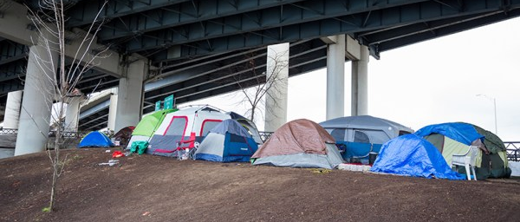
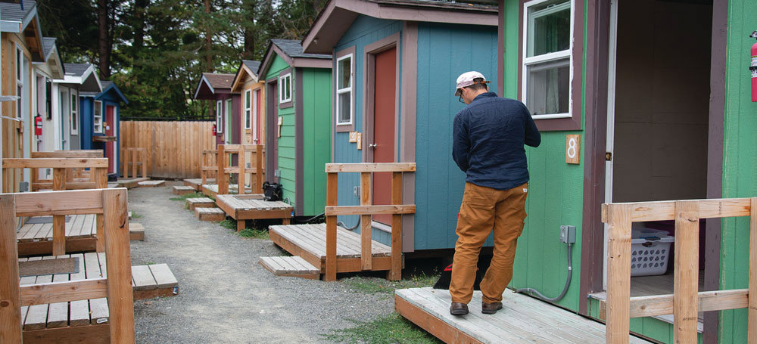
Answering the Call
Creating Solutions for Homelessness

Slide 2
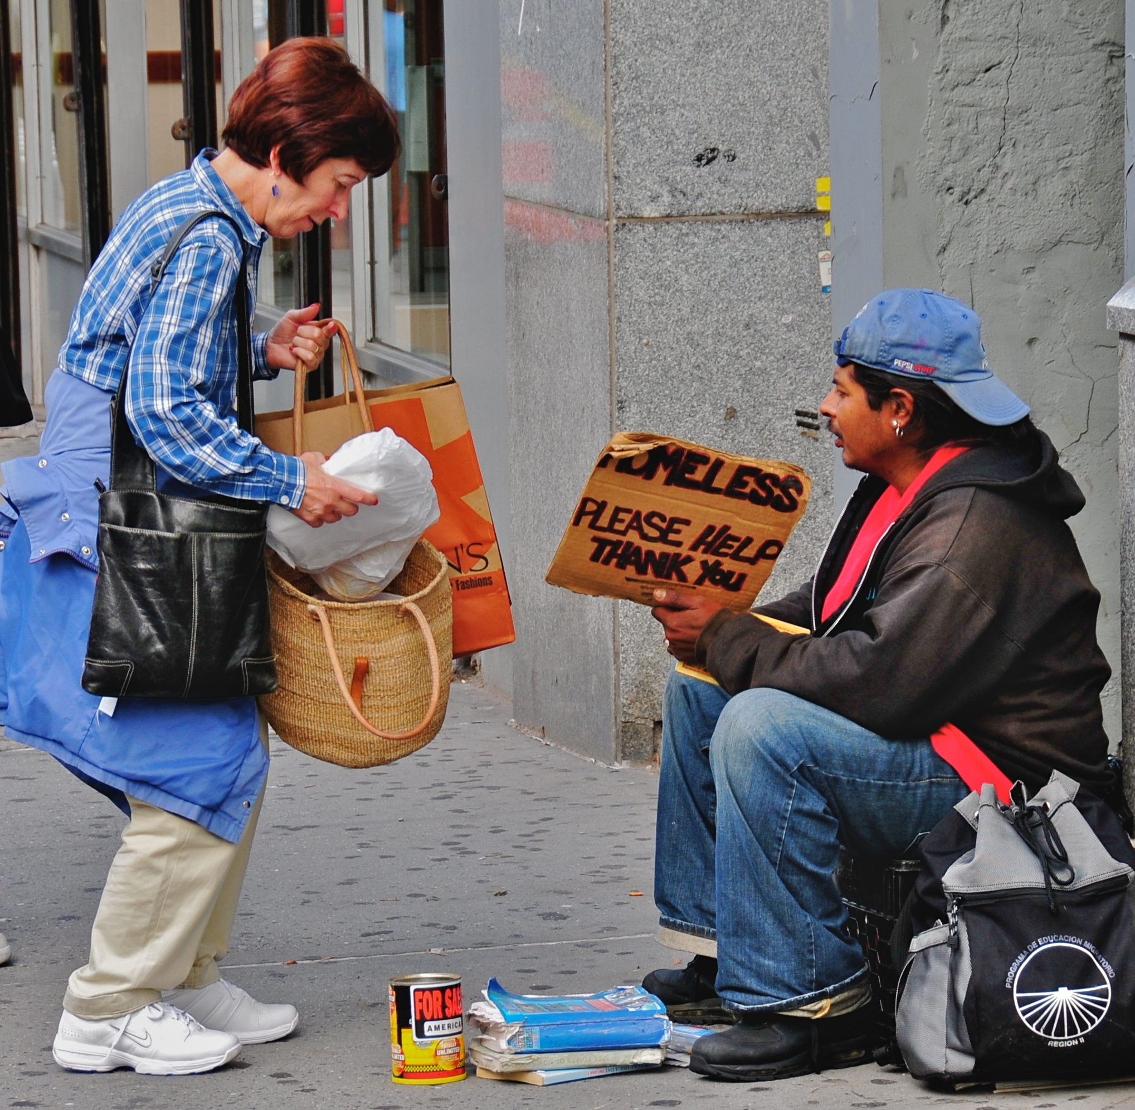
Getting started
Street homelessness/shelter
Housing/Stability
Relief/Charity
Relief
  Live outside as safely and comfortably as possible
  Get inside some of the time
  Meet basic needs
Development/Justice
  Development of a just community
  Name oppressive community behavior
  Change prohibitive policy
  Create true affordability
action
homeless
shelter
housing
stability
ThePhoto by PhotoAuthor is licensed under CCYYSA.

Slide 3
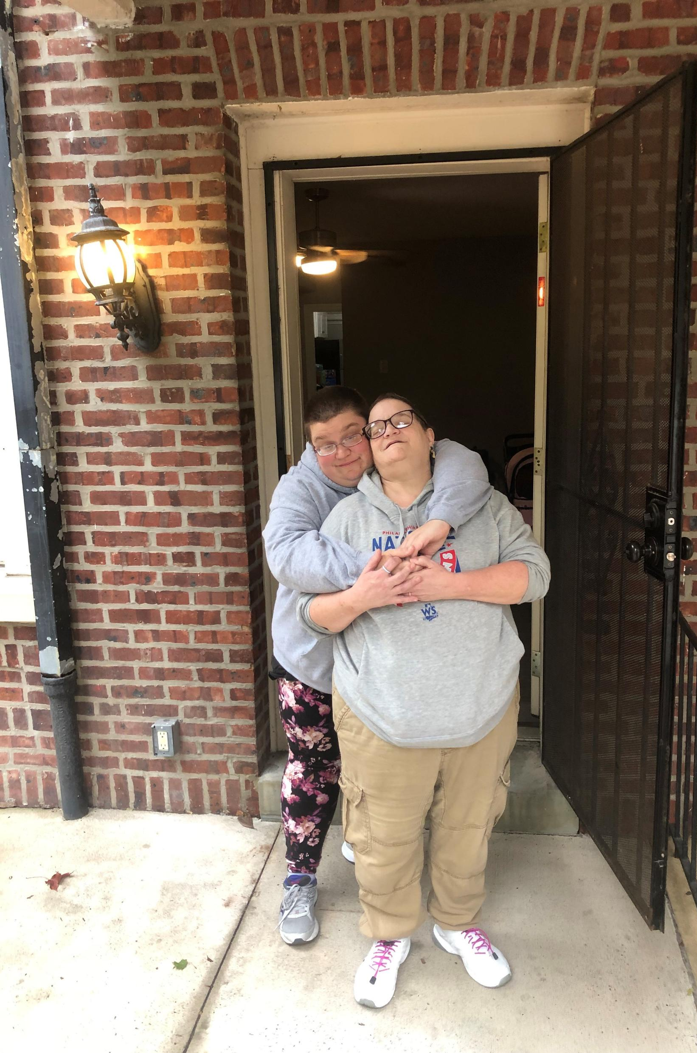

Session 5:
Supporting Housing Stability

Slide 4

In this session
We will hear about the realities of living on a limited income
We will also look at the crisis of eviction
We will look at housing support services and what they do
We will identify the gap space
We will identify things that people can do in the gaps, and brainstorm local action.

Slide 5

"You can't spend what you ain't got"
But first, alphabet soup
  AMI = Area Median Income ~ $80,000/single person
  FMR = Fair Market Rate
    Ranges from $1,200-$2,500 for efficiency
    Ranges from $1,400-$2,700 for 1 bedroom
30% of Area Median Income (AMI) (considered “low income”): $35,820
  Monthly rent affordable at 30% AMI: $896
  F/T income @ $15/hr = $31,000

Slide 6

“And you ain’t got it”
Rental wage: 127hrs/week @ minimum wage to afford 1 bedroom
Fixed incomes: SSI would require 100% of income for the $896/month number
@ 30% or less of AMI: have the greatest percentage of having at least 1 or more of the four severe housing problems (lacks kitchen or complete plumbing, severe overcrowding and severe cost burden).

Slide 7
Eviction Happens. A lot.
Montgomery County has the 3rd highest eviction rate in the state
It is one of 20 (out of 67) counties that are responsible for 87% of all evictions statewide
In 2024 there were 8,585 eviction filings (do the maths)
95% of evictions are due to back rent

Slide 8
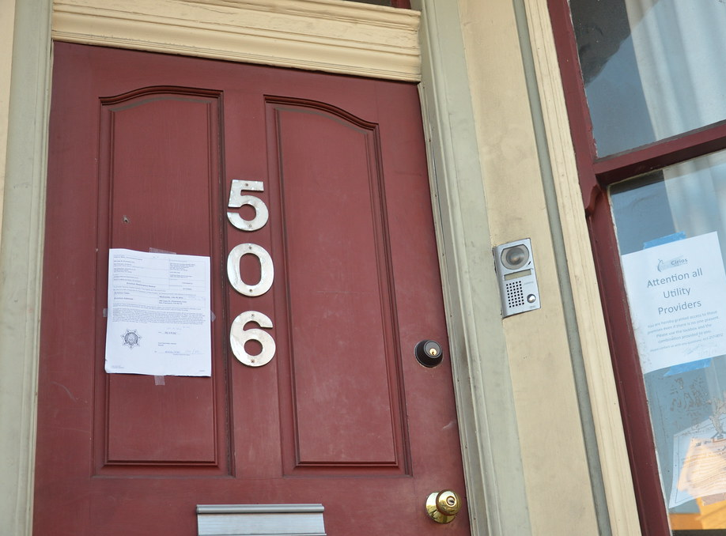
We are manufacturing homelessness instead of housing
The Gap
This Photo by Unknown Author is licensed under CC BY-NC-ND

Slide 9
“Aim Left”: working on upstream prevention
action
homeless
shelter
housing
stability

Slide 10

Keeping people housed is good for all of us
Cost to the taxpayer per person/per year have a person live outside = $35,578
Every $1 spent on rent banking realizes a $5 savings
Supported housing for people with substance use/mental health issues creates a median cost savings of $29,000 per person/per year
Additional cost savings in healthcare costs of 59%

Slide 11

Prevention
What services are doing

Slide 12

EPIC: Eviction prevention in court
It’s really helpful for the people it helps
  448 people (190 households with children) served last year
  85% success rate
There are significant eligibility restrictions
  Severely cost burdened (over 50% of income on housing) are ineligible
  Need to demonstrate ability to sustainably pay rent/utilities
It’s a small service in a big pond (450/8,500 filings)
It’s actually reactive; the eviction has to have already been filed

Slide 13

How Services Support Stability
Case Management
  Varying levels on intensity amongst housing programs
    "Housing Ready" - Lighter touch, connection to resources, shorter term
    "Inside" - Heavier presence and support needed
  Develop Housing Stability Plans where we discuss
    Housing Goals – Stay in a rental? 1 Bedroom? Which area?
    Physical Health Goal - Are you connected to a doctor? Dentist?
    Mental Health Goal - Do you need to see a therapist? Psychiatrist? Support group?
    Financial Goal – How are you gaining income? Job training? Disability application?
    Community Goal – Recovery occurs in community
  "What does independence mean to you?"
    This is ideally the finish line

Slide 14

“Aim Lefter”: Community response to supporting stability

Slide 15
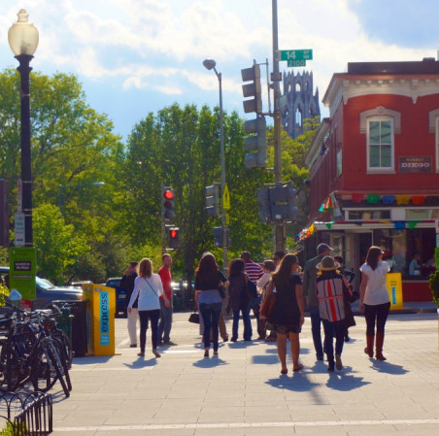
Things that churches have done/can do
Services can’t create community; communities do that
Helpin’ out around the place
Collaborating in the neighborhood
  The curiosity project- looking at the community with new glasses
  Looking at intersectionality X2
  Asset mapping

Slide 16
Brainstorm
In your neighborhood, how can you find out:
Who in the space might be needy
Where the intersections are; where they connect with neighborhood groups
How might you connect with other faith groups in the same area to collaborate?

Slide 17
Resources
https://yourwayhome.org/eviction-prevention-intervention-coalition
https://www.miraclemessages.org/team
  “When we walk by” by Kevin Adler
https://housingalliancepa.org/resources/
https://chalmers.org/training/benevolence/

Slide 18

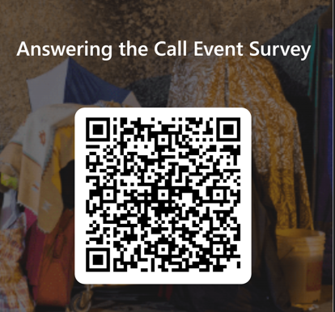
What Did You Think?

Slide 19

How Can You Reach Us?
AnsweringTheCall@AccessServices.org

